Slide 1
Decision trees

Slide 2
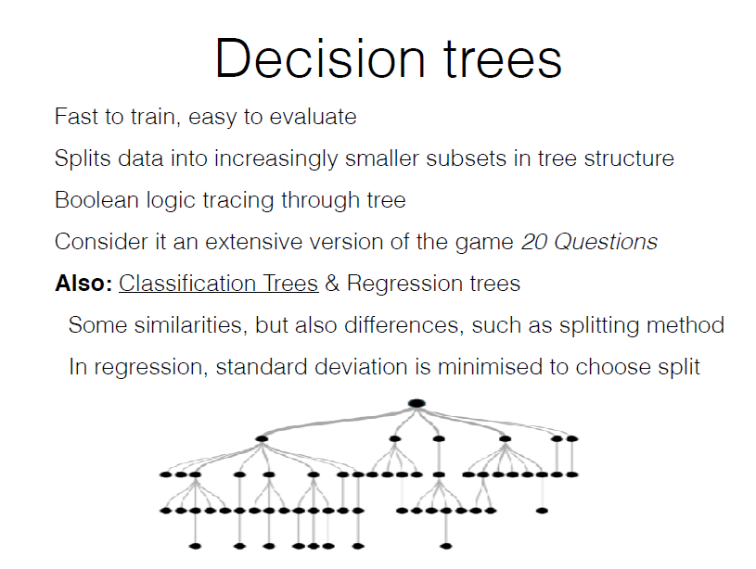

Slide 3
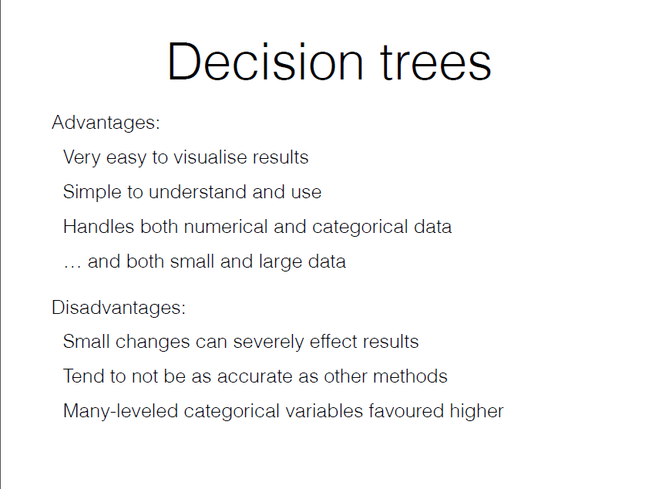

Slide 4
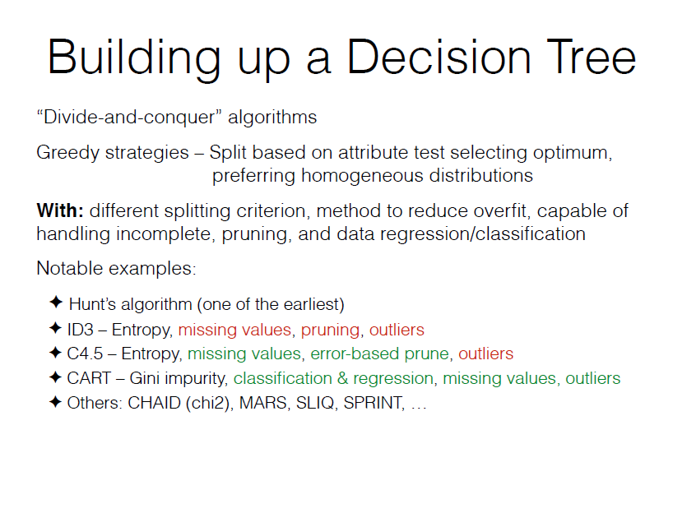

Slide 5
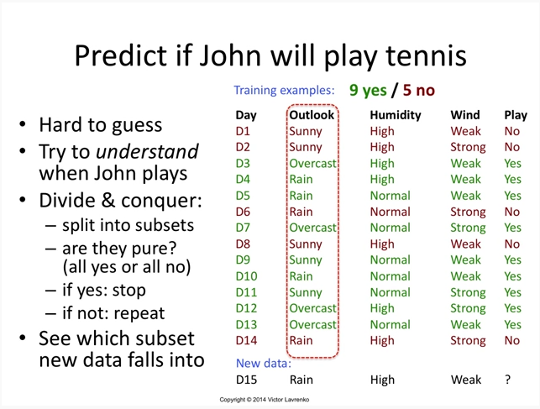

Slide 6
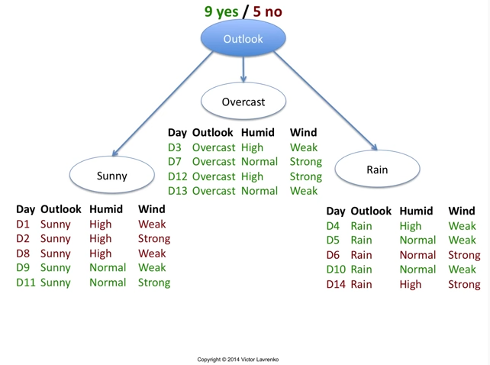

Slide 7
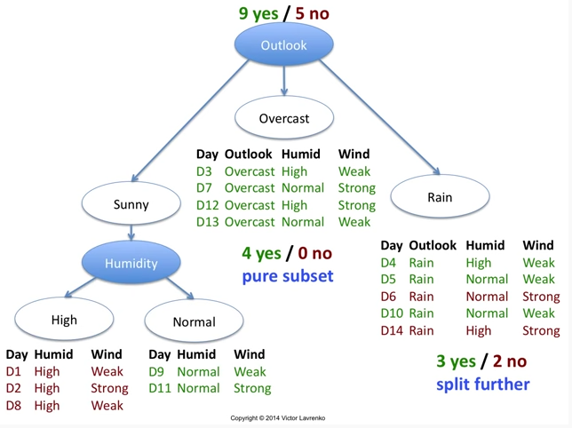

Slide 8
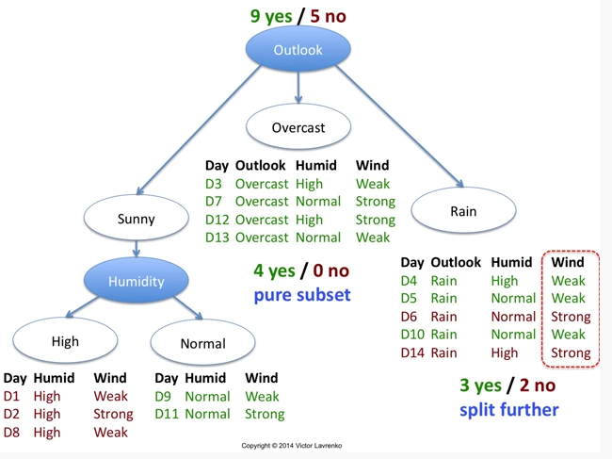

Slide 9
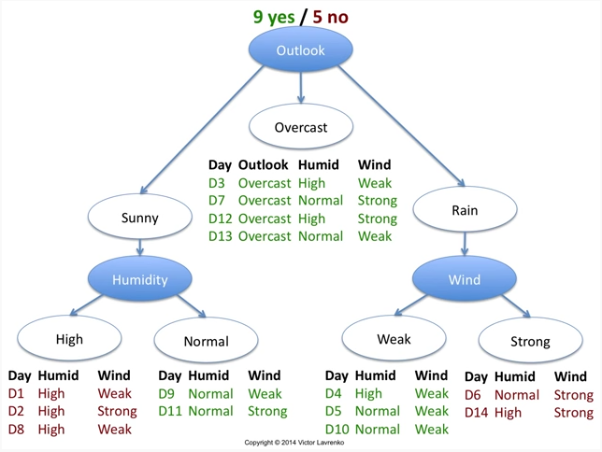

Slide 10
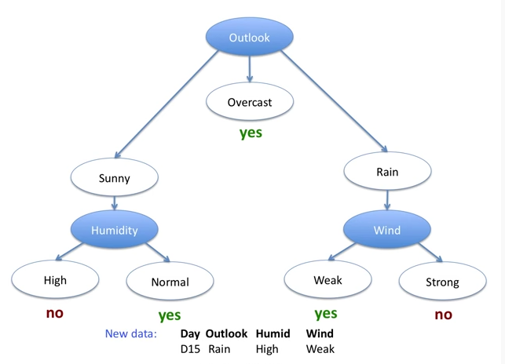
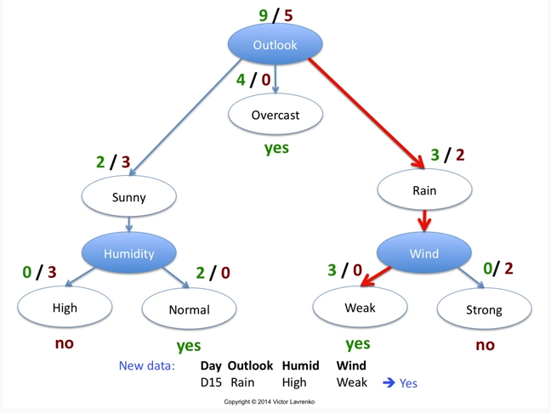


$$?$$

Slide 11
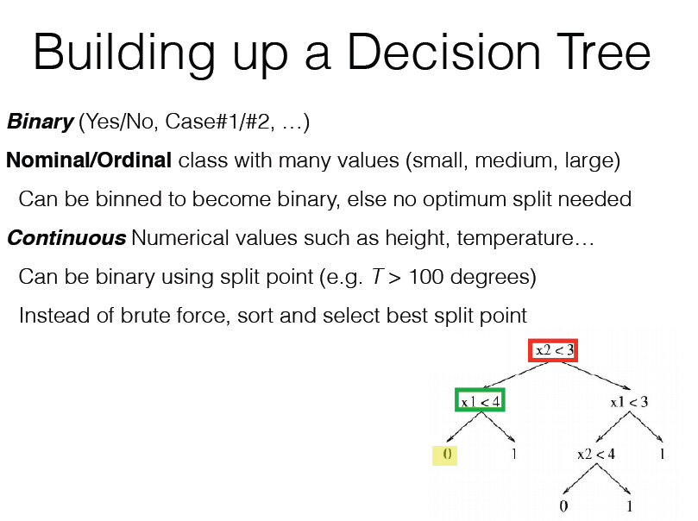

Slide 12
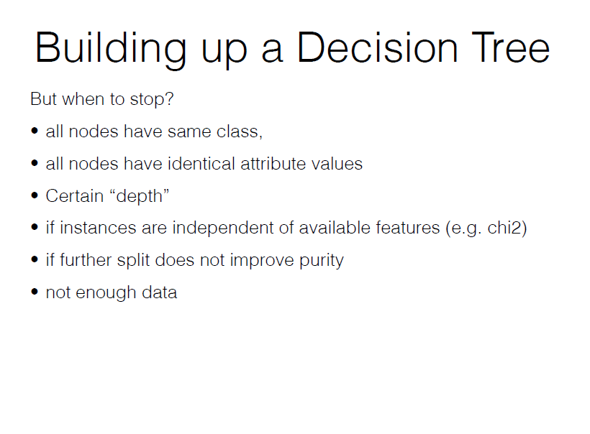

Slide 13
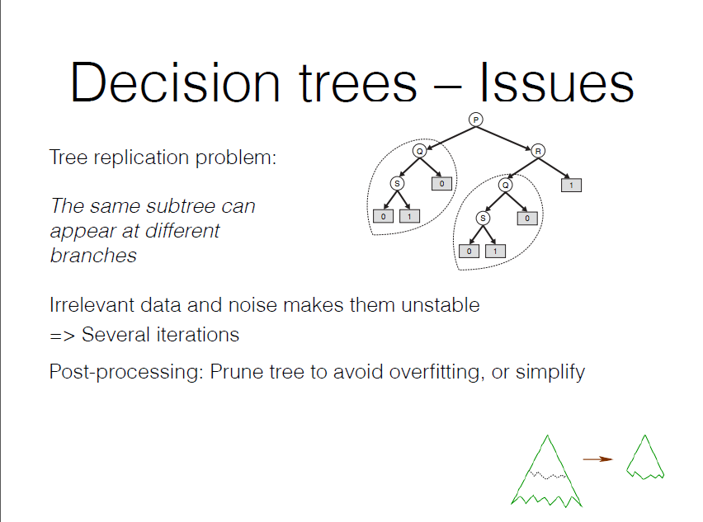
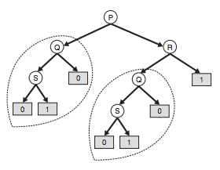

Slide 14
Ensembles of decision trees
Some techniques produce an ensemble of decision trees – Random Forest
Idea: Many weak predictors makes for one strong predictor
Example: You want to know if you’ll like a movie.
You could ask one friend, who needs in-depth questions to know your preferences… or ask many friends, with a smaller list of questions, then “merge” results
They select features (to split on) and data at random
Continue as normal, no pruning
Final result is based on the majority, or average, of the combined classifiers

